Slide 1
Elektrik Devrelerine Giriş
Dr. Meriç ÇETİN
18022019

Slide 2
Dersin Kodu | : | EEEN 103 (4. Yarıyıl-Zorunlu Ders)
Dersin Adı | : | ELEKTRİK-ELEKTRONİK MÜHENDİSLİĞİNE GİRİŞ
Ders Saati | : | 3+2
Dersi Veren | : | Dr. Öğretim Üyesi MERİÇ ÇETİN
Ofis Telefonu | : | 0 258 296 3208
Eposta | : | mcetin@pau.edu.tr
Görüşme saati | : | Çarşamba: 14.00 – 16.00
Değerlendirme | : | Vize: % 35, Lab. Devam: %10, Proje: %15, Final: %40

Slide 3
Dersin Amacı
Bu dersin amacı temel elektrik ve elektronik devre elemanlarını, bu elemanların karakteristiklerini tanıtmak, devre teoremlerini öğretmek ve bu teoremleri kullanarak öğrencilere bir devreyi analiz etme yeteneğini kazandırmaktır.

Slide 4
Dersin İçeriği
Elektrik devre değişkenleri
Devre elemanları, aktif-pasif devre elemanları, bağımlı-bağımsız kaynaklar
Dirençli devreler, kirşof kanunları, akım ve gerilim bölücü devreler,devre analizi
Dirençli devrelerin analiz metotları→ Devre Teoremleri
Düğüm gerilimi analizi,
Çevre akımları analizi
Kaynak dönüşümü,
Süperpozisyon,
Thevenin/Norton teoremleri,
Maksimum güç transferi
Enerji depolayan elemanlar. Kapasitörler, bobinler
Elektroniğe giriş, yükselticiler, yükseltici devre modelleri, işlemsel yükselteçler-Op Amp,ideal Op Amp içeren devre analizleri
Diyotlar,diyot Devrelerinin analizi,zener diyotlar, doğrultucu devreler,kırpıcı ve bağlayıcı devreler
İki kutuplu jonksiyon transistörleri-BJTs, aktif moddaki npn ve pnp transistör işlemleri
DC/AC ortamında transistörlü devre çözümleri
Alan etkili transistörler-FETs
DC ortamda alan etkili transistör devre çözümleri

Slide 5
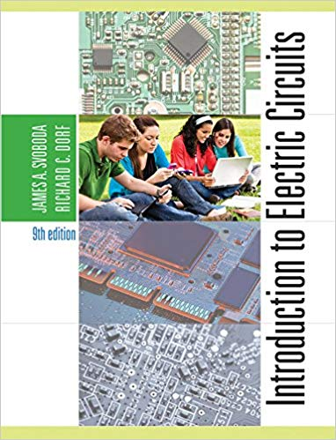
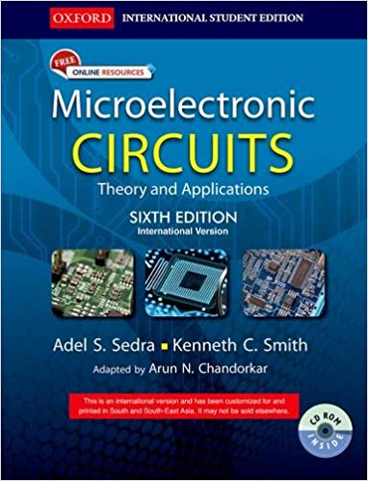
Kaynaklar
Teori için
“Introduction to Electric Circuits”, James Svoboda, Richard Dorf
“Microelectronic Circuits”, Adel S. Sedra, Kenneth C. Smith
Uygulama için
“Arduino Robotics”, John D. Warren, Josh Adams, Harald Molle
“Beginning Arduino”, Michael McRoberts
“30 Arduino Projects for the Evil Genius”, Simon Monk
EDS duyurularını takip ediniz.

Slide 6
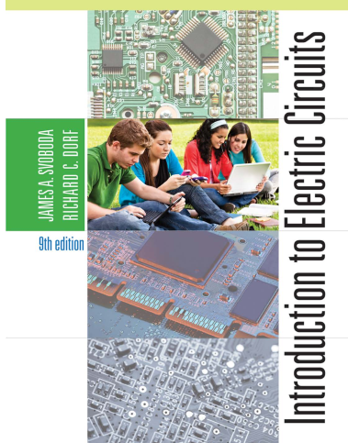
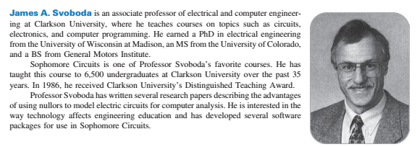
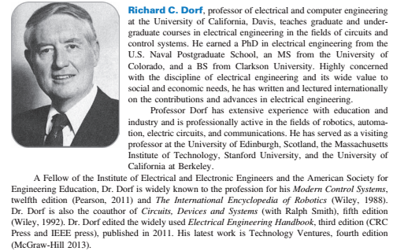

Slide 7
Timeline of electrical and electronic engineering
600 B.C. | Thales of Miletus discovered static electricity by rubbing fur on substances such as amber
1600 | English scientist William Gilbert coined the word electricus after careful experiments.
1705 | English scientist Francis Hauksbee made a glass ball that glowed when spun and rubbed with the hand
1720 | English scientist Stephen Gray made the distinction between insulators and conductors
1745 | German physicist Ewald Georg von Kleist and Dutch scientist Pieter van Musschenbroek invented Leyden jars
1752 | American scientist Benjamin Franklin showed that lightning was electrical by flying a kite, and explained how Leyden jars work
1780 | Italian scientist Luigi Galvani discovered the Galvanic action in living tissue

Slide 8
Timeline of electrical and electronic engineering
1785 | French physicist Charles-Augustin de Coulomb formulated and published Coulomb's law in his paper Premier Mémoire sur l’Électricité et le Magnétisme
1785 | French mathematician Pierre-Simon Laplace developed the Laplace transform to transform a linear differential equation to an algebraic equation. Later, his transform became a tool in circuit analysis.
1800 | Italian physicist Alessandro Volta invented the battery
1808 | Atomic theory by John Dalton
1816 | English inventor Francis Ronalds built the first working electric telegraph
1820 | Danish physicist Hans Christian Ørsted accidentally discovered that an electric field creates a magnetic field
1820 | One week after Ørsted's discovery, French physicist André-Marie Ampère published his law. He also proposed right-hand screw rule

Slide 9
Timeline of electrical and electronic engineering
1821 | German scientist Thomas Johann Seebeck discovered thermoelectricity
1825 | English physicist William Sturgeon developed the first electromagnet
1827 | German physicist Georg Ohm introduced the concept of electrical resistance
1831 | English physicist Michael Faraday published the law of induction (Joseph Henry developed the same law independently)
1831 | American scientist Joseph Henry in United States developed a prototype DC motor
1832 | French instrument maker Hippolyte Pixii in France developed a prototype DC generator
1833 | Michael Faraday developed laws of electrolysis
1833 | Michael Faraday invented thermistor

Slide 10
Timeline of electrical and electronic engineering
1833 | English Samuel Hunter Christie invented Wheatstone bridge (It is named after Charles Wheatstone who popularized it)
1836 | Irish priest (and later scientist) Nicholas Callan invented transformer in Ireland
1837 | English scientist Edward Davy invented the electric relay
1839 | French scientist Edmond Becquerel discovered the Photovoltaic Effect
1844 | American inventor Samuel Morse developed telegraphy and the Morse code
1845 | German physicist Gustav Kirchhoff developed two laws now known as Kirchhoff's Circuit laws
1850 | Belgian engineer Floris Nollet invented (and patented) a practical AC generator

Slide 11
Timeline of electrical and electronic engineering
1851 | Heinrich Daniel Ruhmkorff first coil, which he patented in 1851
1855 | First utilization of AC (in electrotherapy) by French neurologist Guillaume Duchenne
1856 | Belgian engineer Charles Bourseul proposed telephony
1856 | First electrically powered light house in England
1860 | German scientist Johann Philipp Reis invented Microphone
1862 | Scottish physicist James Clerk Maxwell published four equations bearing his name
1866 | Transatlantic telegraph cable
1873 | Belgian engineer Zenobe Gramme who developed DC generator accidentally discovered that a DC generator also works as a DC motor during an exhibit in Vienna.

Slide 12
Timeline of electrical and electronic engineering
1876 | Russian engineer Pavel Yablochkov invented electric carbon arc lamp
1876 | Scottish inventor Alexander Graham Bell patented the telephone
1877 | First street lighting in Paris, France
1877 | American inventor Thomas Alva Edison invented phonograph
1877 | German industrialist Werner von Siemens developed primitive loudspeaker
1878 | First hydroelectric plant in Cragside, England

Slide 13
Timeline of electrical and electronic engineering
1878 | English engineer Joseph Swan invented Incandescent light bulb
1879 | American physicist Edwin Herbert Hall discovered Hall Effect
1879 | Thomas Alva Edison introduced a long lasting filament for the incandescent lamp.
1880 | French physicists Pierre Curie and Jacques Curie discovered Piezoelectricity
1882 | First thermal power stations in London and New York
1883 | English physicist J J Thomson invented waveguides
1887 | German American inventor Emile Berliner invented gramophone record
1888 | German physicist Heinrich Hertz proves the existence of electromagnetic waves, including what would come to be called radio waves.

Slide 14
Timeline of electrical and electronic engineering
1888 | Italian physicist and electrical engineer Galileo Ferraris publishes a paper on the induction motor and Serbian-American engineer Nikola Tesla gets a US patent on the same device^{[3][4]}
1890 | Thomas Alva Edison invents the fuse
1893 | During the Fourth International Conference of Electricians in Chicago electrical units were defined
1894 | Russian physicist Alexander Stepanovich Popov finds a use for radio waves, building a radio receiver that can detect lightning strikes
1895 | Discovery of X-rays by Wilhelm Röntgen
1896 | First successful intercontinental telegram
1897 | German inventor Karl Ferdinand Braun invented cathode ray oscilloscope (CRO)
1900 | Italian inventor Guglielmo Marconi builds first radio communication system, based on radiotelegraphy

Slide 15
Timeline of electrical and electronic engineering
1901 | First transatlantic radio transmission by Guglielmo Marconi
1901 | American engineer Peter Cooper Hewitt invented Fluorescent lamp
1904 | English engineer John Ambrose Fleming invented diode
1906 | American inventor Lee de Forest invented triode
1908 | Scottish engineer Alan Archibald Campbell-Swinton, laid the principles of Television.
1911 | Dutch physicist Heike Kamerlingh Onnes discovered Superconductivity
1912 | American engineer Edwin Howard Armstrong developed Electronic oscillator
1915 | French physicist Paul Langevin and Russian engineer Constantin Chilowsky invented sonar
1917 | American engineer Alexander M. Nicholson invented crystal oscillator

Slide 16
Timeline of electrical and electronic engineering
1918 | French physicist Henri Abraham and Eugene Bloch invented multivibrator
1919 | Edwin Howard Armstrong developed standard AM radio receiver
1921 | Metre Convention was extended to include the electrical units
1921 | Edith Clarke invents the "Clarke calculator", a graphical calculator for solving line equations involving hyperbolic function, allowing electrical engineers to simplify calculations for inductance and capacity in power transmission lines^{[5]}
1925 | Austrian American engineer Julius Edgar Lilienfeld patented the first FET (which became popular much later)
1926 | Yagi-Uda antenna was developed by the Japanese engineers Hidetsugu Yagi and Shintaro Uda
1927 | American engineer Harold Stephen Black invented negative feedback amplifier

Slide 17
Timeline of electrical and electronic engineering
1927 | German Physicist Max Dieckmann invented Video camera tube
1928 | First experimental Television broadcast in the US.
1929 | First public TV broadcast in Germany
1931 | First wind energy plant in the Soviet Union
1936 | Dudley E. Foster and Stuart William Seeley developed FM detector circuit.
1936 | Austrian engineer Paul Eisler invented Printed circuit board
1936 | Scottish Scientist Robert Watson-Watt developed the Radar concept which was proposed earlier.

Slide 18
Timeline of electrical and electronic engineering
1938 | Russian American engineer Vladimir K. Zworykin developed Iconoscope
1939 | Edwin Howard Armstrong developed FM radio receiver
1939 | Russell and Sigurd Varian developed the first Klystron tube in the US.
1941 | German engineer Konrad Zuse developed the first programmable computer in Berlin
1944 | Scottish Engineer John Logie Baird developed the first color picture tube
1945 | Transatlantic telephone cable
1947 | American engineers John Bardeen and Walter Houser Brattain together with their group leader William Shockley invented transistor.

Slide 19
Timeline of electrical and electronic engineering
1948 | Hungarian-British physicist Dennis Gabor invented Holography
1950 | French physicist Alfred Kastler invented MASER
1951 | First nuclear power plant in the US
1953 | First fully transistorized computer in the US
1958 | American engineer Jack Kilby invented the integrated circuit (IC)
1960 | American engineer Theodore Harold Maiman invented the LASER
1962 | Nick Holonyak Jr. invented the LED
1963 | First home Videocassette recorder (VCR)
1963 | Electronic calculator
2008 | American scientist Richard Stanley Williams invented memristor which was proposed by Leon O. Chua in 1971

Slide 20
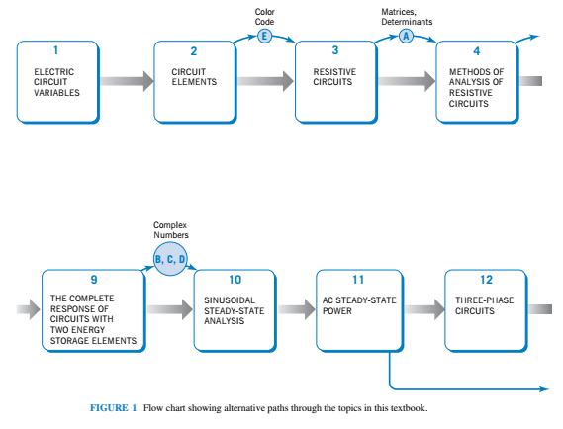

Slide 21
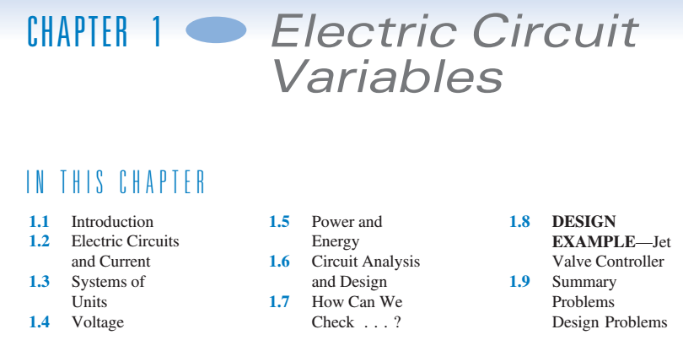

Slide 22
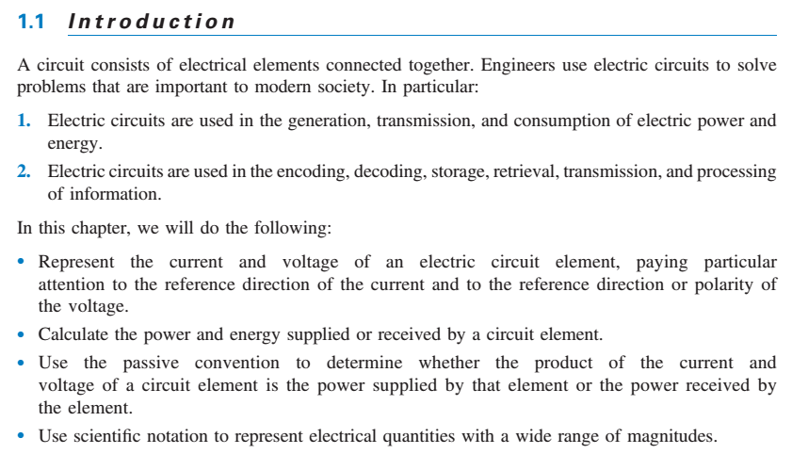

Slide 23
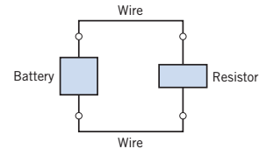
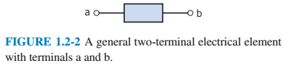

Slide 24
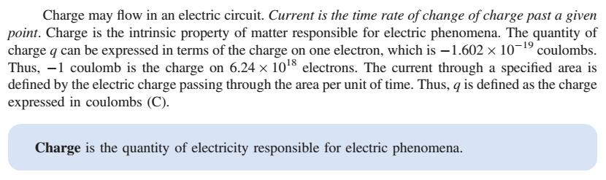
1C = 6.24x10¹⁸ elektron
1e = 1.602x10⁻¹⁹ coulomb

Slide 25
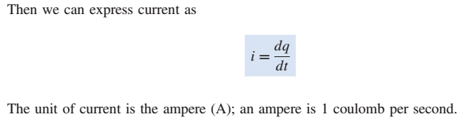

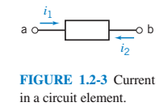

Slide 26
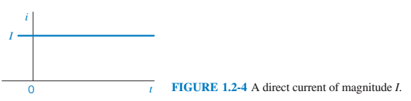

Slide 27
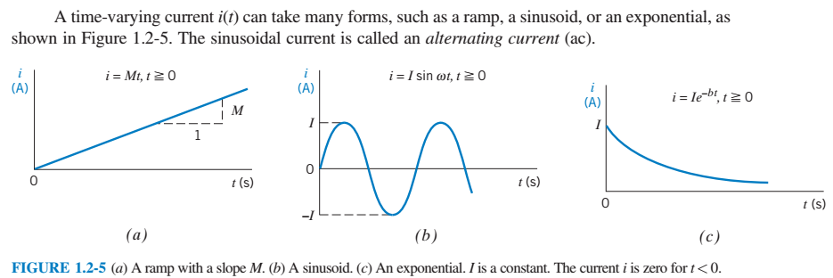

Slide 28
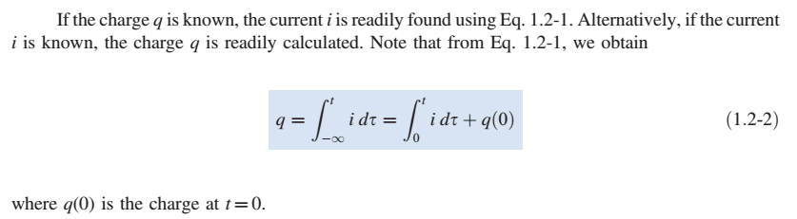

Slide 29
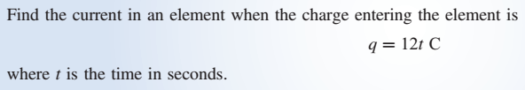



Slide 30
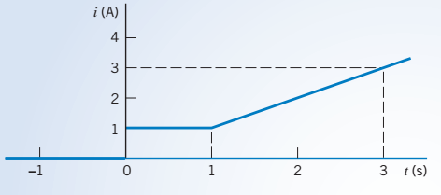

Slide 31

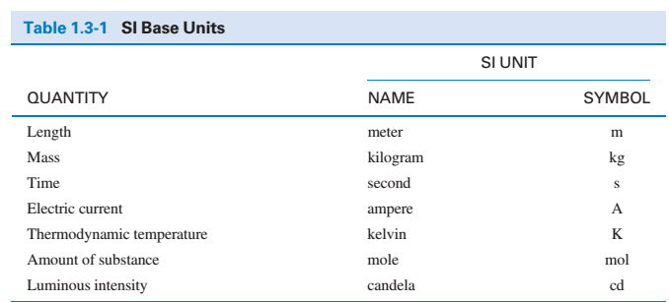

Slide 32
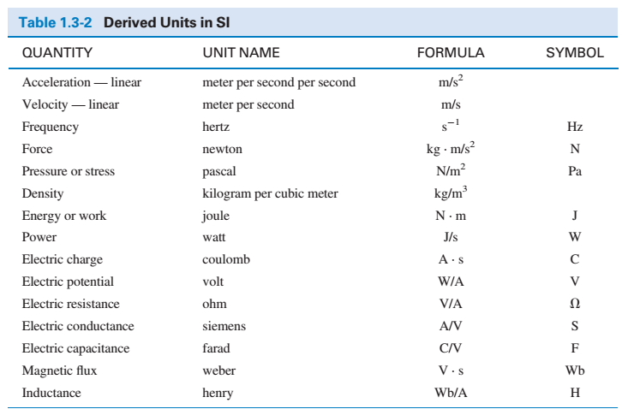

Slide 33
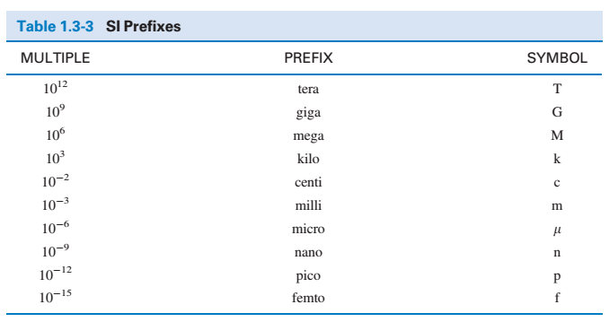

Slide 34
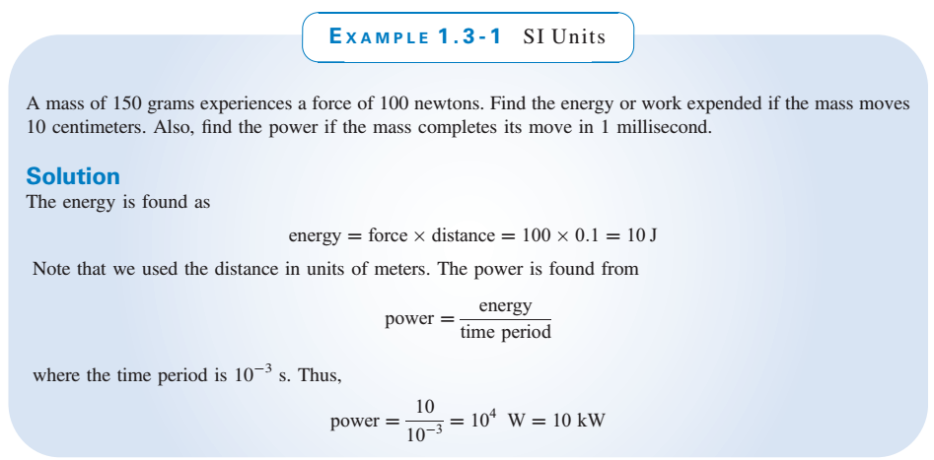

Slide 35

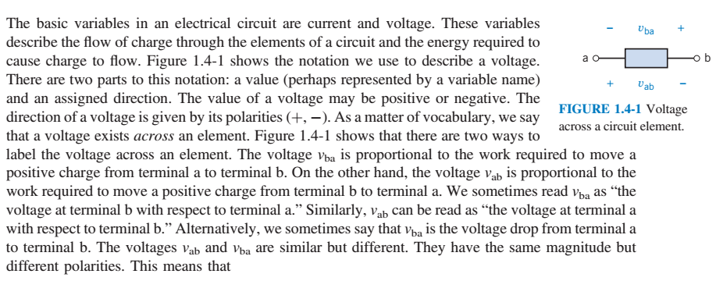


Slide 36
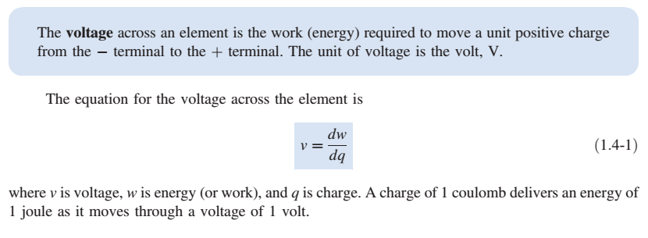

Slide 37

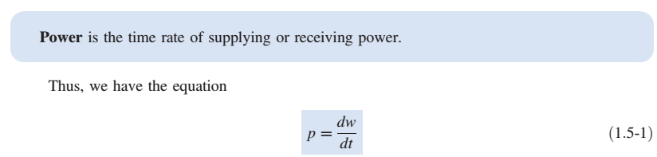
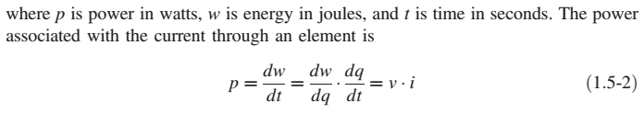

Slide 38
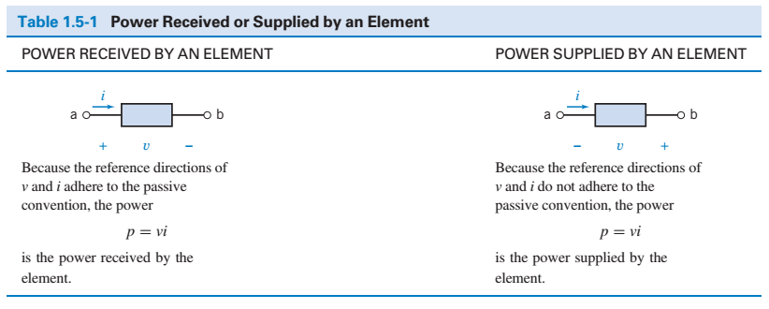


Slide 39
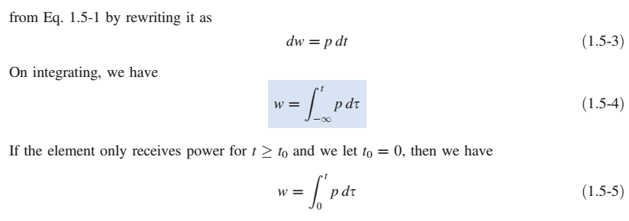

Slide 40
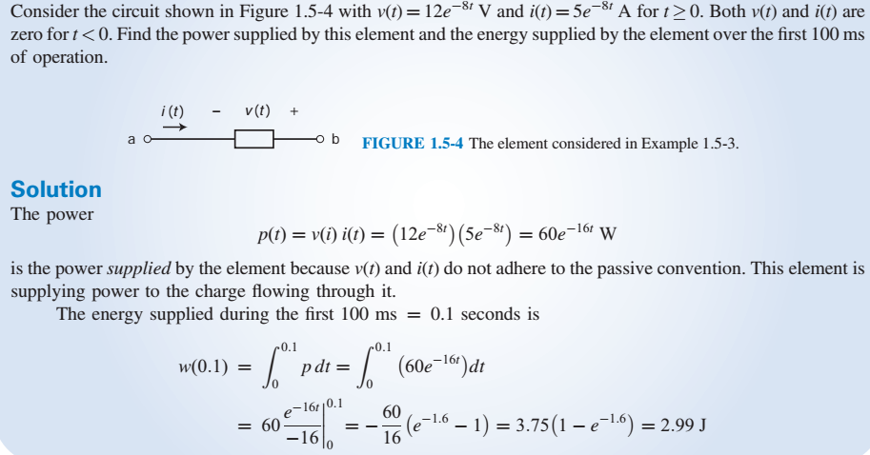

Slide 41
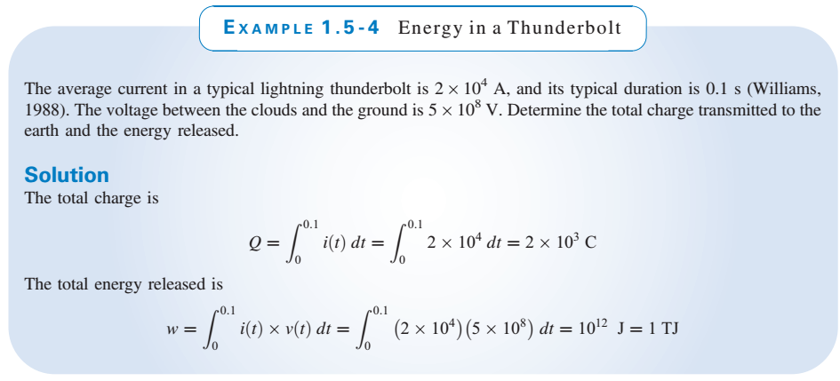

Slide 42

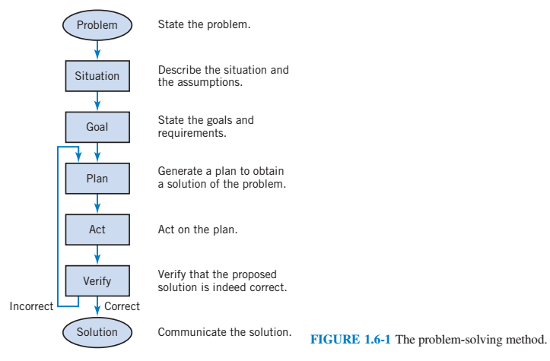

Slide 43
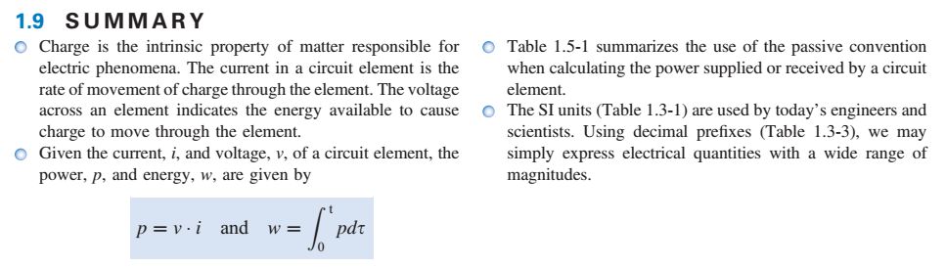

Slide 44
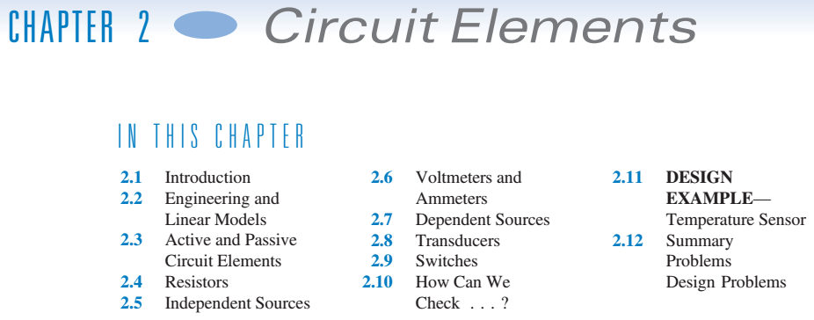

Slide 45
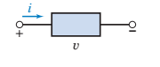
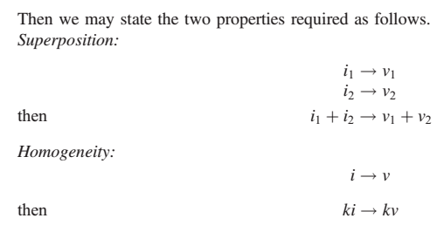

Slide 46
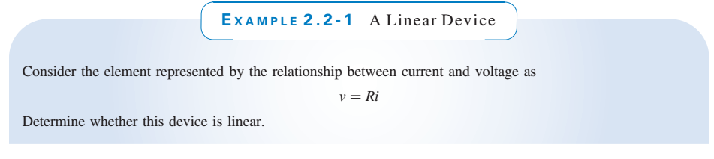
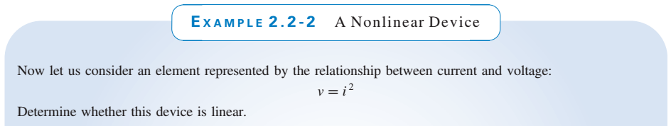

Slide 47



Slide 48

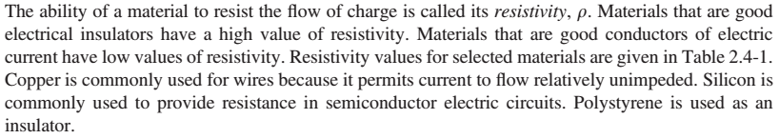
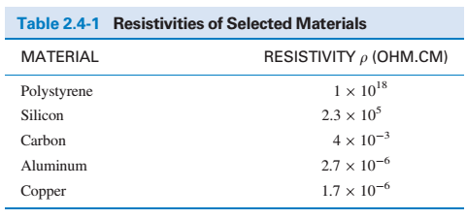

Slide 49
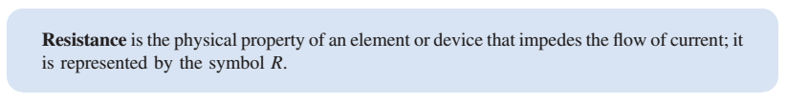
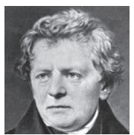
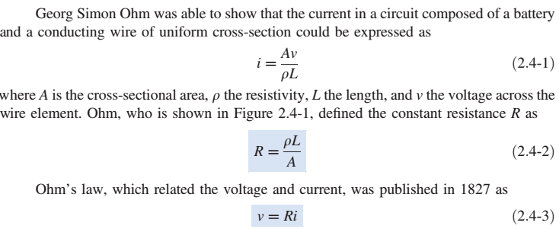
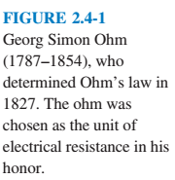

Slide 51
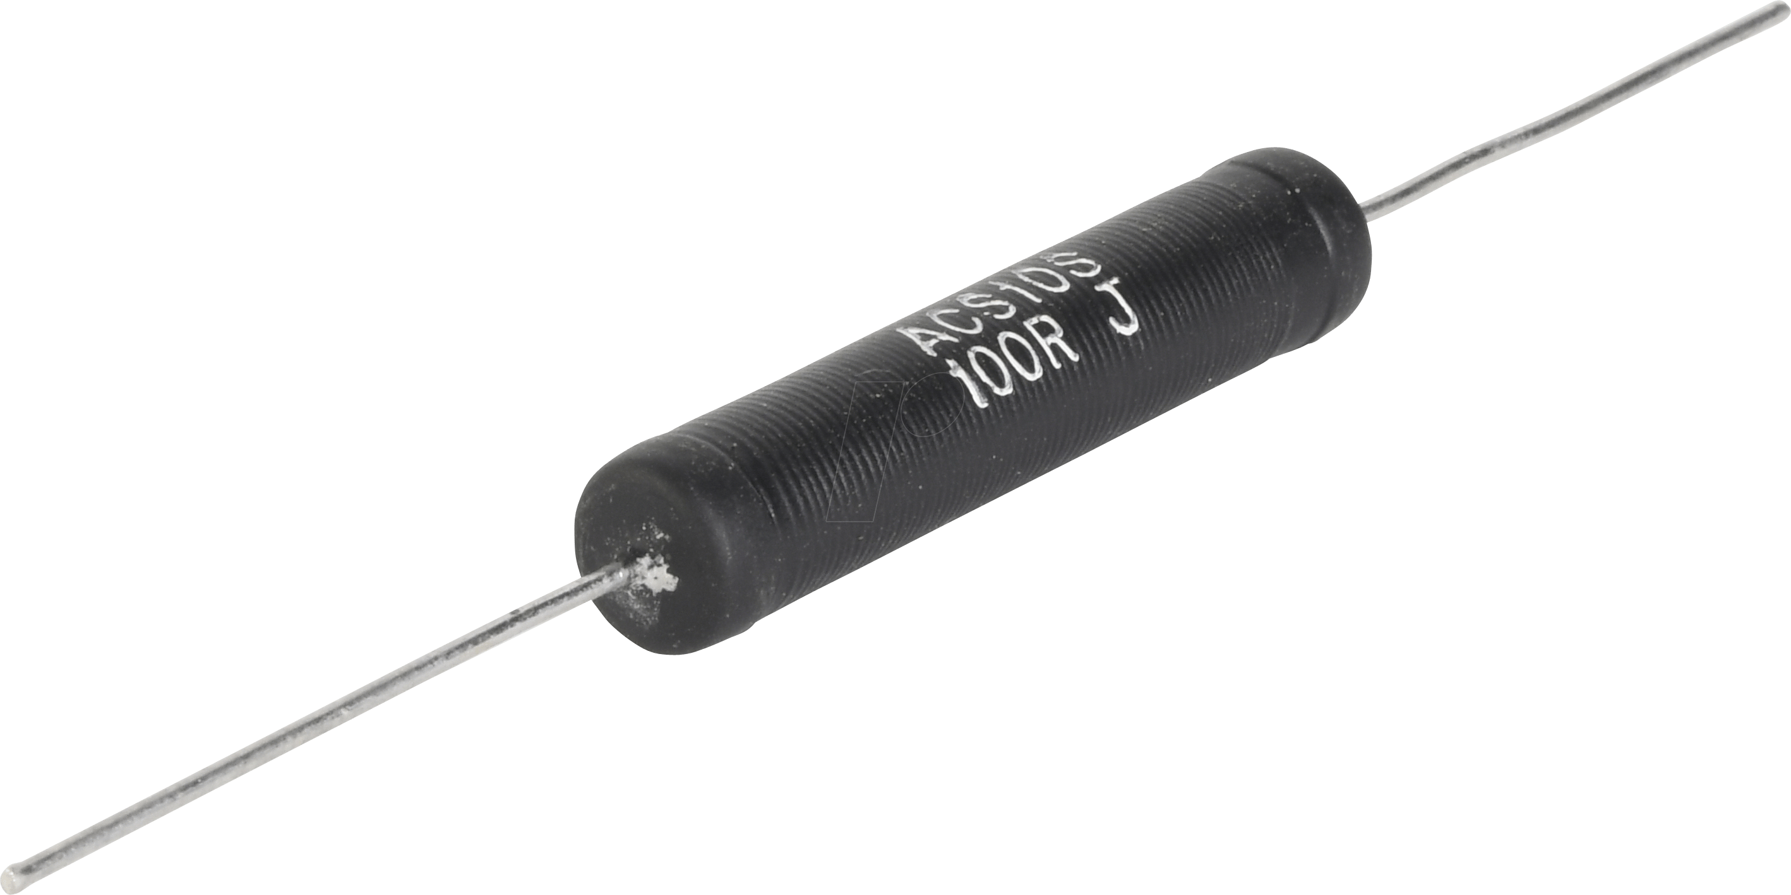
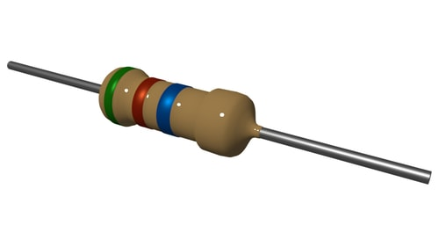
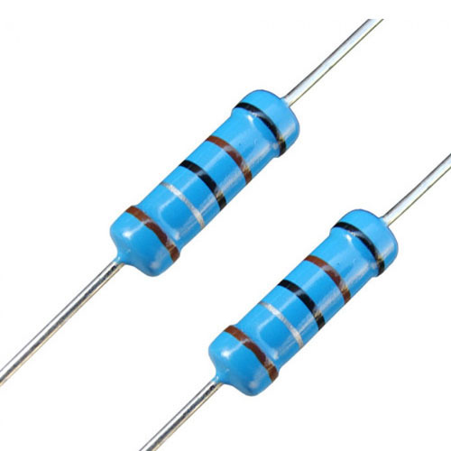
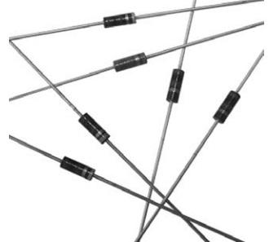
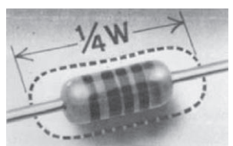

Slide 52
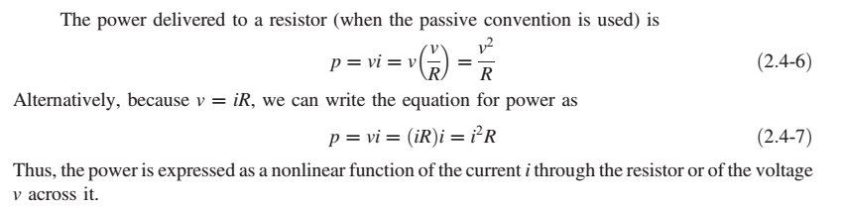

Slide 53
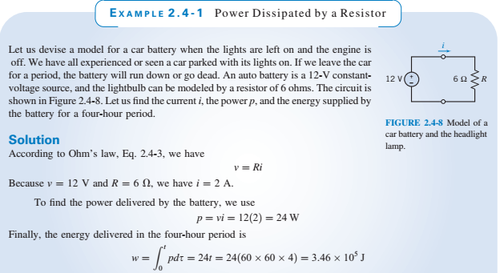

Slide 54







Slide 55


Slide 56





Slide 57


Slide 58


Slide 59


Slide 60




Slide 61


Slide 62


Slide 63



Slide 64




